Slide 1

Advanced Data Structures Trees And Graphs

Slide 2
What Are We Going To COVER
Tree-Like Data Structures
Traversing Trees And Traversal Order
Binary Trees
Heaps & Priority Queues
Balanced Binary Search Trees & AVL Trees
B-Trees & Red-Black Trees
Interval Trees
Rope & Trie
Graphs

Slide 3
Recommendation
Try to implement all the data structures by yourself
After you understand the main theory behind them
If you have any issues, look at the provided examples
Complete the exercise at the end of the workshop
It needs multiple data structures and decisions around them
It will test your data structure skills and performance optimizations
This lecture is advanced and difficult
You may need to watch it more than once!

Slide 4
Tree-like Data Structures

Slide 5
Tree-like Data Structures
Tree-like data structures are:
Branched recursive data structures
Consisting of nodes
Each node connected to other nodes
Many different tree data structures out there
Tree
17
*
Binary Tree
9
14
15
+
-
6
5
8
3
2
9
6

Slide 6
Tree-like Data Structures
Examples of tree-like structures
Trees: binary, balanced, ordered, etc.
Graphs: directed / undirected, weighted, etc.
Networks: graphs with attributes
Network
Graph
5 (20)
2
7
1
1
14
5 (10)
4
10 (40)
20(20)
6
21
15 (15)
3
11
15 (30)
5 (5)
12
19
31
4
5

Slide 7
Tree Data Structure – Terminology
Node, Edge
Root, Parent, Child, Sibling
Depth, Height
Subtree
Internal node, Leaf
Ancestor, Descendant
Root
17
Depth 0
9
14
15
Depth 1
6
5
8
Depth 2
Leaf
Height = 3

Slide 8
Tree Traversal Algorithms

Slide 9
Tree Traversal Algorithms
Traversing a tree means to visit each of its nodes exactly once
The order of visiting nodes may vary on the traversal algorithm
Depth-First Search (DFS)
Visit node's successors first
Usually implemented by recursion
Breadth-First Search (BFS)
Nearest nodes visited first
Implemented by a queue

Slide 10
Depth-First Search (DFS)
Depth-First Search (DFS) first visits all descendants of given node recursively, finally visits the node itself
9
7
DFS (node)
{
for each child c of node
DFS(c);
print node;
}
4
19
5
21
8
14
1
2
3
6
7
1
12
31
23
6

Slide 11
DFS in Action (Step 1)
Start DFS from the tree root
7
Stack: 7
Output: (empty)
19
21
14
1
12
31
23
6

Slide 12
DFS in Action (Step 2)
Enter recursively into the first child
7
Stack: 7, 19
Output: (empty)
19
21
14
1
12
31
23
6

Slide 13
DFS in Action (Step 3)
Enter recursively into the first child
7
Stack: 7, 19, 1
Output: (empty)
19
21
14
1
12
31
23
6

Slide 14
DFS in Action (Step 4)
Return back from recursion and print the last visited node
7
Stack: 7, 19
Output: 1
19
21
14
1
12
31
23
6

Slide 15
DFS in Action (Step 5)
Enter recursively into the first child
7
Stack: 7, 19, 12
Output: 1
19
21
14
1
12
31
23
6

Slide 16
Breadth-First Search (BFS)
Breadth-First Search (BFS) first visits the neighbor nodes, then the neighbors of neighbors, etc.
1
7
BFS (node)
{
queue ← node
while queue not empty
v ← queue
print v
for each child c of v
queue ← c
}
2
19
3
21
4
14
5
6
7
8
9
1
12
31
23
6

Slide 17
BFS in Action (Step 1)
Initially enqueue the root node
7
Queue: 7
Output:
19
21
14
1
12
31
23
6

Slide 18
BFS in Action (Step 2)
Remove from the queue the next node and print it
7
Queue: 7
Output: 7
19
21
14
1
12
31
23
6

Slide 19
BFS in Action (Step 3)
Enqueue all children of the current node
7
Queue: 19
Output: 7
19
21
14
1
12
31
23
6

Slide 20
BFS in Action (Step 4)
Enqueue all children of the current node
7
Queue: 19, 21
Output: 7
19
21
14
1
12
31
23
6

Slide 21
BFS in Action (Step 5)
Enqueue all children of the current node
7
Queue: 19, 21, 14
Output: 7
19
21
14
1
12
31
23
6

Slide 22
BFS in Action (Step 6)
Remove from the queue the next node and print it
7
Queue: 21, 14
Output: 7, 19
19
21
14
1
12
31
23
6

Slide 23
BFS in Action (Step 7)
Enqueue all children of the current node
7
Queue: 21, 14, 1
Output: 7, 19
19
21
14
1
12
31
23
6

Slide 24
Binary Trees

Slide 25
Binary Trees
Binary trees: the most widespread form
Each node has at most 2 children (left and right)
Root node
17
Right child
Left
subtree
9
15
6
5
8
Left child

Slide 26
Binary Trees Traversal: Pre-order
17
Root → Left → Right
PreOrder (node)
{
if (node != null)
print node.Value
PreOrder(node.Left)
PreOrder(node.Right)
}
9
25
3
11
20
31
→ 17 9 3 11 25 20 13

Slide 27
Binary Trees Traversal: In-order
17
Left → Root → Right
InOrder (node)
{
if (node != null)
PreOrder(node.Left)
print node.Value
PreOrder(node.Right)
}
9
25
3
11
20
31
→ 3 9 11 17 20 25 31
BST: Sorted Order

Slide 28
Binary Trees Traversal: Post-order
17
Left → Right → Root
InOrder (node)
{
if (node != null)
PreOrder(node.Left)
PreOrder(node.Right)
print node.Value
}
9
25
3
11
20
31
→ 3 11 9 17 20 31 25

Slide 29
Binary Search Trees
Binary search trees are ordered
For each node x
Elements in left subtree of x are < x
Elements in right subtree of x are > x
17
9
25
nodes are < 17
3
11
20
31

Slide 30
BST – Search
Search for x in BST
if node is not null
if x < node.value → go left
else if x > node.value → go right
else if x == node.value → return node
17
9
19
6
12
25
Search 12 → 17 9 12
Search 27 → 17 19 25 null

Slide 31
BST – Insert
17
Insert x in BST
if node is null → insert x
else if x < node.value → go left
else if x > node.value → go right
else → node exists
9
19
6
12
25
Insert 12 → 17 9 12 return
Insert 27 → 17 19 25 null(insert)

Slide 32
BST – Remove
Remove x from BST
if node is null → exit
if node is leaf → remove
if node is non-leaf → find replacement
3 cases
17
9
19
6
18
25

Slide 33
BST – Remove (1)
17
1. Deleted has no right child
promote its left child
Example: Delete 9
9
19
6
18
25

Slide 34
BST – Remove (2)
17
2. Deleted right's child has no left child
promote right child
Example: Delete 19
9
19
6
18
25
null

Slide 35
BST – Remove (3)
17
3. Deleted right's child has left child
find min in deleted right's left
promote min
Example: Delete 17
9
19
6
18
25

Slide 36
BST – Speed
Insert – height of tree
Search – height of tree
Delete – height of tree
17
9
19
6
18
25

Slide 37
Heaps & Priority Queues

Slide 38
Priority Queue
Retains a specific order to the elements
Higher priority elements are pushed to the beginning of the queue
Lower priority elements are pushed to the end of the queue

Slide 39
Priority Queue
Priority queue abstract data type (ADT) supports:
Insert(element)
Pull() → max/min element
Peek() → max/min element
Where element has a priority

Slide 40
Priority Queue – Complexity Goal
Unsorted Resizing Array
ex.
Sorted Resizing Array
ex.
2 | 4 | 1 | 3 | 5
1 | 2 | 3 | 4 | 5
 | Insert | Pull | Peek
Unsorted Array
Sorted Array
Goal
O(1)
O(N)
O(N)
O(N)
O(1)
O(1)
O(logN)
O(logN)
O(logN)

Slide 41
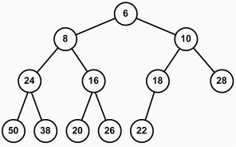
What is a Heap?
Heap
Tree-based data structure
Stored in an array
Heaps hold the heap property for each node:
Min Heap
parent ≤ children
Max Heap
parent ≥ children

Slide 42
Binary Heap
5
4
1
3
2
Binary heap
Represents a Binary Tree
Shape property - Binary heap is a complete binary tree:
Every level, except the last, is filled
Last is filled from left to right
0 | 1 | 2 | 3 | 4
5
4
1
3
2

Slide 43
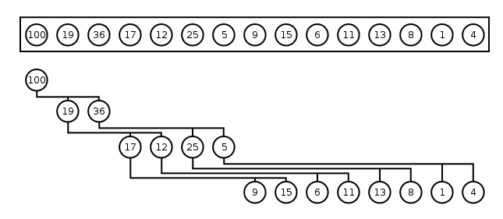
Binary Heap – Array Implementation
Binary heaps can be efficiently stored in arrays:
Parent(i) = (i - 1) / 2
Left(i) = 2 * i + 1; Right(i) = 2 * i + 2
0 | 1 | 2 | 3 | 4 | 5 | 6 | 7 | 8 | 9 | 10 | 11 | 12 | 13 | 14

Slide 44
Heap Insertion
To preserve heap properties:
Insert at the end
Heapify element up
Right: Max Heap
Insert 16
Insert 25
17
Satisfy heap property
Promote while element > parent
9
15
6
5
8
16
25

Slide 45
Heap Deletion
25
To preserve heap properties:
Save first element
Swap first with last
Heapify first down
Return element
Right: Max Heap
Pull – returns 25
Demote while element < greater child
25
17
16
9
5
8
15
6

Slide 46
Heap Construction from Array
To construct a heap:
Heapify Down from i = N/2 to 0
2
Heap with 1 element
Heap with 3 elements
4
1
3
5
2
4
1
3
5
0 | 1 | 2 | 3 | 4

Slide 47
Priority Queue Applications
Data Compression
Graph Shortest Path / GPS
Pathfinding / AI
Many others

Slide 48
Balanced Binary Search Trees

Slide 49
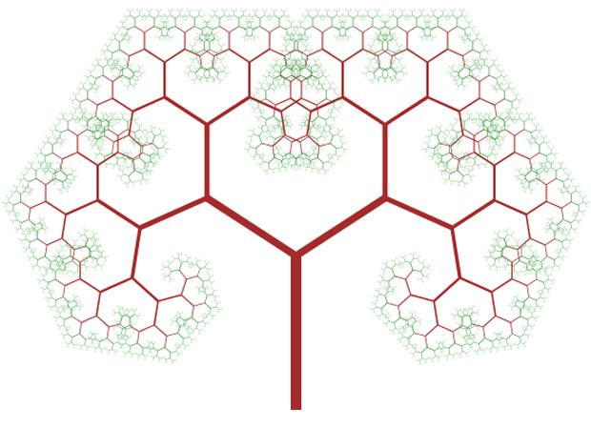
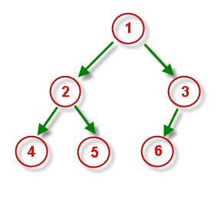
What is a Balanced Binary Search Tree?
Binary search trees can be balanced
Subtrees hold nearly equal number of nodes
Subtrees are with nearly the same height

Slide 50
Balanced Binary Search Tree – Example
The left subtree holds 7 nodes
33
The right subtree holds 6 nodes
The left subtree has height of 3
18
54
The right subtree has height of 3
15
24
42
60
3
17
20
29
37
43
85

Slide 51
AVL Trees

Slide 52
AVL Tree
AVL tree is a self-balancing binary-search tree (visualization)
Height of two subtrees can differ by at most 1
17
 | Average | Worst case
Space | O(n) | O(n)
Search | O(log n) | O(log n)
Insert | O(log n) | O(log n)
Delete | O(log n) | O(log n)
9
25
5
12

Slide 53
AVL Tree Rebalancing
Height difference is measured by a balance factor (BF)
BF(Tree) = Height(Left) – Height(Right)
BF of any node is in the range [-1, 1]
If BF becomes -2 or 2 → rebalance
0
17
0
1
9
25
0
0
5
12
20
0

Slide 54
AVL Tree Rebalancing
Rebalancing is done by retracing
Start from inserted node's parent and go up to root
Perform rotations to restore balance
0
-1
17
0
1
9
25
2
0
0
5
12
20
0
1
19
0

Slide 55
Right Rotation
x
y
Set to be child of
Set Right Child of to be Left Child of
y
x
x
y
C
A
Right rotation (x)
y
x
A
B
B
C

Slide 56
Left Rotation
y
x
Set to be child of
Set Left Child of to be Right Child of
x
y
y
x
A
C
Left rotation (y)
x
y
B
C
A
B

Slide 57
AVL Tree Insertion Algorithm
4
20
Insert like in ordinary BST
Retrace up to root
Modify balance / height
If balance factor ∉ [-1,1] → rebalance
3
2
12
25
2
2
1
8
17
26
1
1
1
1
4
10
15
19

Slide 58
Insertion - #1
4
20
3
2
Insert 11
12
25
2
2
1
8
17
26
1
1
1
1
4
10
15
19

Slide 59
Insertion - #2
4
20
3
2
11 < → go left
20
12
25
2
2
1
8
17
26
1
1
1
1
4
10
15
19

Slide 60
Insertion - #3
4
20
3
2
11 < → go left
12
12
25
2
2
1
8
17
26
1
1
1
1
4
10
15
19

Slide 61
Insertion - #4
4
20
3
2
11 > → go right
8
12
25
2
2
1
8
17
26
1
1
1
1
4
10
15
19

Slide 62
Insertion - #5
4
20
3
2
11 > → go right
10
12
25
2
2
1
8
17
26
1
1
1
1
4
10
15
19

Slide 63
Insertion - #5
4
20
3
2
Right node is null → insert
Update height
balance is -1
12
25
10
2
2
1
10
8
17
26
1
2
1
1
4
10
15
19
1
11

Slide 64
Insertion - #5
4
20
3
2
Update height
balance is -1
8
12
25
8
3
2
1
8
17
26
1
2
1
1
4
10
15
19
1
11

Slide 65
Insertion - #5
4
20
4
2
Update height
balance is 1
12
12
25
12
3
2
1
8
17
26
1
2
1
1
4
10
15
19
1
11

Slide 66
Insertion - #5
5
20
4
2
Update height
balance is 2
is left heavy
Rotate right
20
12
25
20
3
2
1
20
8
17
26
20
1
2
1
1
4
10
15
19
1
11

Slide 67
Insertion - #5
4
12
5
Switch parent
17
3
20
8
2
2
1
2
17
25
4
10
1
1
1
1
11
15
19
26

Slide 68
Insertion - #5
4
12
20
3
Update height
Update height
Balance is 0
3
20
12
8
2
2
12
1
2
17
25
4
10
1
1
1
1
11
15
19
26

Slide 69
Insertion - #5
4
12
3
Over
More: https://en.wikipedia.org/wiki/AVL_tree
3
20
8
2
2
1
2
17
25
4
10
1
1
1
1
11
15
19
26

Slide 70
Single Rotation Problem
Happens when the parent node have a positive balance
And the child has a negative
The opposite is also true
2
5
D
-1
3
A
0
4
B
C

Slide 71
Single Rotation Problem
Insert 4
2
5
D
-1
3
A
0
4
B
C

Slide 72
Single Rotation Problem
Rotate a node with opposite balanced child
2
-2
Rotate Right 5 doesn’t solve it
5
3
D
A
-1
1
3
5
A
D
0
0
4
4
B
C
B
C

Slide 73
Double Right Rotation
Rotate Right (node) with negatively balanced Left Child
2
5
D
-1
3
A
0
4
B
C

Slide 74
Double Right Rotation
Left Rotate 3
2
5
D
-1
3
A
0
4
B
C

Slide 75
AVL Tree - Double Rotations
Update Balance 3
2
5
D
0
4
C
-1
3
A
B

Slide 76
AVL Tree - Double Rotations
Update Balance 3
2
5
D
0
4
C
0
3
A
B

Slide 77
AVL Tree - Double Rotations
Right Rotate (5)
2
Reduced to Single Right (5)
5
D
1
4
C
0
3
A
B

Slide 78
AVL Tree - Double Rotations
Update Balance 5
1
4
0
2
3
5
A
B
C
D

Slide 79
AVL Tree - Double Rotations
Update Balance 4
1
4
0
0
3
5
A
B
C
D

Slide 80
AVL Tree - Double Rotations
Balance Restored!
0
4
0
0
3
5
A
B
C
D

Slide 81
B-Trees

Slide 82
What are B-Trees?
B-trees are generalization of the concept of ordered binary search trees – see the visualization
B-tree of order b has between b and 2*b keys in a node and between b+1 and 2*b+1 child nodes
The keys in each node are ordered increasingly
All keys in a child node have values between their left and right parent keys
B-trees can be efficiently stored on the hard disk

Slide 83
B-Tree – Example
B-Tree of order 3 (max count of child nodes)
Also known as 2-3 tree
13
7
11
41
3
5
9
12
32
50
73

Slide 84
B-Trees vs. Other Balanced Search Trees
B-Trees hold a range of child nodes, not a single one
B-trees do not need frequent re-balancing
B-Trees are good for database indexes
Because a single node is stored in a single cluster of the hard drive
Minimize the number of disk operations (which are very slow)
B-Trees are almost perfectly balanced
The count of nodes from the root to any null node is the same

Slide 85
Definition
A 2-3 search tree can contain:
Empty node (null)
2-node with 1 key and 2 links (children)
3-node with 2 keys and 3 links (children)
As usual for BSTs, all items to the left are smaller, all items to the right are larger

Slide 86
2-3 Tree Example
3-node with 2 keys and 3 links
13
2-node with 1 key and 2 links
Smaller than 7
7
11
41
Larger than 11
3
5
9
12
32
50
73
Larger than 7, smaller than 11

Slide 87
2-3 Tree Searching
Identical to BST Search
Searching for 12
13
7
11
41
3
5
9
12
32
50
73

Slide 88
2-3 Tree Insertion (at 2-node)
Becomes a 3-node
13
30

Slide 89
2-3 Tree Insertion (at 3-node)
Temporary
4-node
13
30
50

Slide 90
2-3 Tree Insertion
Into a 3-node whose parent is a 2-node
9
9
Insert 40
31
52
31
40
52
9
40
31
52

Slide 91
2-3 Tree Insertion (2)
Into a 3-node whose parent is a 3-node
30
50
30
50
Insert 25
10
20
10
20
25
30
20
30
50
20
50
10
25
10
25

Slide 92
2-3 Tree Construction
50
Insert 50

Slide 93
2-3 Tree Construction (2)
30
50
Insert 30

Slide 94
2-3 Tree Construction (3)
30
35
50
Insert 35
35
30
50

Slide 95
2-3 Tree Construction (4)
35
Insert 20
20
30
50

Slide 96
2-3 Tree Construction (5)
35
Insert 10
10
20
30
50
20
35
10
30
50

Slide 97
2-3 Tree Construction (6)
20
35
Insert 70
10
30
50
70

Slide 98
2-3 Tree Construction (7)
20
35
Insert 33
10
30
33
50
70

Slide 99
2-3 Tree Construction (8)
20
35
Insert 40
10
30
33
40
50
70
20
35
50
10
30
33
40
70

Slide 100
2-3 Tree Construction (9)
35
20
50
10
30
33
40
70

Slide 101
2-3 Tree Properties
Unlike standard BSTs, 2-3 trees grow from the bottom
The number of links from the root to any null node is the same
Transformations are local
Nearly perfectly balanced
Inserting 10 nodes will result with height of the tree 2
For normal BSTs the height can be 9 in the worst case

Slide 102
2-3 Tree Performance
Structure | Worst case |  |  | Average case
 | Search | Insert | Delete | Search Hit | Insert
BST | N | N | N | 1.39 lg N | 1.39 lg N
2-3 Tree | c lg N | c lg N | c lg N | c lg N | c lg N
Constants depend on implementation

Slide 103
Red-black Trees

Slide 104
Representing 3-Nodes from 2-3 Tree
We will represent 3-nodes with a left-leaning red nodes
Nodes with values between the 2 nodes will be to the right of the red node
30
20
30
20

Slide 105
Red-Black Tree Properties
All leaves are black
The root is black
No node has two red links connected to it
Every path from a given node to its descendant leaf nodes contains the same number of black nodes
Red links lean left

Slide 106
Rotations
Rotations are used to correct the balance of a tree
Balance can be measured in height, depth, size, etc. of subtrees
17
Right subtree weights more
25
90

Slide 107
Left Rotation
Orient a right-leaning red link to lean left
In Order Preserved
y
x
Left rotation (y)
x
y

Slide 108
Right Rotation
Orient a left-leaning red link to lean right (temporarily)
In Order Preserved
x
y
Right rotation (x)
y
x

Slide 109
Insertion Algorithm
Locate the node position
Create new red node
Add the new node to the tree
Balance the tree if needed

Slide 110
Insertion
Larger element
The red node is leaning right, we need left rotation
Insert into a single 2-node:
Smaller element
73
73
80
50
80
The red node is leaning left
73

Slide 111
Insertion (2)
Insert smaller item into a 2-node at the bottom:
13
11
41
The red node is leaning left
7
73
5
9
50

Slide 112
Insertion (3)
Insert larger item into a 2-node at the bottom:
13
13
11
41
11
41
7
73
7
80
5
9
80
5
9
73
The red node is leaning right
Left rotation

Slide 113
Insertion Into 3-Node
3 cases:
The element is smaller than both keys
The element is larger than both keys
The element is between the 2 keys

Slide 114
Insertion Into 3-Node (2)
Larger than both keys:
Flipping the colors increases the tree height, which maintains the 1-1 correspondence to 2-3 trees
Flip the colors
13
13
11
41
11
41

Slide 115
Insertion Into 3-Node (3)
Smaller than both keys:
13
Left-Heavy tree, needs right rotation
11
11
9
13
9
11
9
13
Flip the colors

Slide 116
Insertion Into 3-Node (4)
30
Between the keys:
50
Right-Leaning red link - Left Rotation
20
50
20
30
50
30
30
20
50
20

Slide 117
Flipping Colors
Flipping the colors should also change the parent color to red
Preserves perfect black balance in the tree!
Keep in mind the root should always be black!
void FlipColors(Node node)
{
node.Color = Red;
node.Left.Color = Black;
node.Right.Color = Black;
}

Slide 118
Keeping Black Root
Insert on a single node (root):
Each time the root switches colors, the height of the tree is increased
30
30
30
20
50
20
50
20
50

Slide 119
Insert Into 3-Node at the Bottom
Insert 8
5
5
3
19
3
18
1
18
1
8
19
5
8
3
18
1
8
19

Slide 120
Insert Into 3-Node at the Bottom (2)
18
5
5
19
3
18
3
8
1
8
19
1

Slide 121
Overall Insertion Process
Left
Rotate
Right Rotate
Flip
Colors

Slide 122
Red-Black Tree - Summary
Structure | Worst case |  |  | Average case
 | Search | Insert | Delete | Search Hit | Insert
BST | N | N | N | 1.39 lg N | 1.39 lg N
2-3 Tree | c lg N | c lg N | c lg N | c lg N | c lg N
Red-Black | 2 lg N | 2 lg N | 2 lg N | lg N | lg N

Slide 123
Trees Performance
Structure | Worst case |  |  | Average case
 | Search | Insert | Delete | Search Hit | Insert
BST | N | N | N | 1.39 lg N | 1.39 lg N
2-3 Tree | c lg N | c lg N | c lg N | c lg N | c lg N
Red-Black | 2 lg N | 2 lg N | 2 lg N | lg N | lg N
AVL Tree | 1.44 lg N | 1.44 lg N | 1.44 lg N | lg N | lg N
Insert/Delete perform O(lgN) rotations

Slide 124
Interval trees

Slide 125
Interval Trees
Interval tree is a modified BST that stores intervals
Efficient search for any or all intervals that overlap a given interval
(20..36)
(3..41)
(29..99)
 | Average | Worst case
Space | O(n) | O(n)
Search | O(log n + m) | O(log n + m)
Insert | O(log n) | O(log n)
Delete | O(log n) | O(log n)
(0..1)
(10..15)
(25..30)

Slide 126
Interval Intersection
A and B intersects if:
Overlapping
Non overlapping
A.start < B.end && A.end > B.start
А
A
A
A
B
B
B
B
A
A
B
B

Slide 127
Interval Trees Implementation
Elements are ordered by interval start
In-order by interval start
(20..36)
99
(3..41)
41
(29..99)
99
(0..1)
1
(10..15)
15
(25..30)
30

Slide 128
Interval Trees Implementation (2)
Each node stores subtree max endpoint
Subtree max endpoint
(20..36)
99
(3..41)
41
(29..99)
99
(0..1)
1
(10..15)
15
(25..30)
30

Slide 129
Search Any #1
Search for i = (12, 19)
Start at (20, 36)
x.left.max > i.start → left
(20..36)
99
(3..10)
15
(29..99)
99
(0..1)
1
(10..15)
15
(25..30)
30

Slide 130
Search Any #2
Search for i = (12, 19)
x.left.max is not ≥ i.start → right
(20..36)
99
(3..10)
15
(29..99)
99
(0..1)
1
(10..15)
15
(25..30)
30

Slide 131
Search Any #3
Search for i = (12, 19)
x intersects i → return x
(20..36)
99
(3..10)
15
(29..99)
99
(0..1)
1
(10..15)
15
(25..30)
30

Slide 132
Search Any - Miss #1
Search for i = (102, 110)
x.left.max is not ≥ i.start → right
(20..36)
99
(3..10)
15
(29..99)
99
(0..1)
1
(10..15)
15
(25..30)
30

Slide 133
Search Any - Miss #2
Search for i = (102, 110)
x.left.max is not ≥ i.start → right
(20..36)
99
(3..10)
15
(29..99)
99
(0..1)
1
(10..15)
15
(25..30)
30

Slide 134
Search Any - Miss #2
Search for i = (102, 110)
x = null → return null
(20..36)
99
(3..10)
15
(29..99)
99
(0..1)
1
(10..15)
15
(25..30)
30
null

Slide 135
Search All
For given interval i we search:
All nodes to the left where x.left.max > i.start
All nodes to the right where x.right.start < i.end
(20..36)
99
(3..10)
15
(29..99)
99
All intersecting (9, 50)
(0..1)
1
(10..15)
15
(25..30)
30

Slide 136
Search All #1
Search for i = (9, 50)
(20, 36) intersects (9, 50)
x.left.max > i.start → go left
Result: (20,36)
(20..36)
99
(3..10)
15
(29..99)
99
(0..1)
1
(10..15)
15
(25..30)
30
(60..72)
72

Slide 137
Search All #2
Search for i = (9, 50)
(3, 41) intersects (9, 50)
x.left.max not > i.start → skip left
Result: (20,36), (3,10)
(20..36)
99
(3..10)
15
(29..99)
99
(0..1)
1
(10..15)
15
(25..30)
30
(60..72)
72

Slide 138
Search All #3
Search for i = (9, 50)
(3, 41) intersects (9, 50)
x.right.start < i.end → go right
Result: (20,36), (3,10)
(20..36)
99
(3..10)
15
(29..99)
99
(0..1)
1
(10..15)
15
(25..30)
30
(60..72)
72

Slide 139
Search All #4
Search for i = (9, 50)
(10, 15) intersects (9, 50)
left & right = null → go up
Result: (20,36), (3,10), (10,15)
(20..36)
99
(3..10)
15
(29..99)
99
(0..1)
1
(10..15)
15
(25..30)
30
(60..72)
72

Slide 140
Search All #5
Search for i = (9, 50)
left & right = done → go up
Result: (20,36), (3,10), (10,15)
(20..36)
99
(3..10)
15
(29..99)
99
(0..1)
1
(10..15)
15
(25..30)
30
(60..72)
72

Slide 141
Search All #6
Search for i = (9, 50)
left = done
x.right.start < i.end → go right
Result: (20,36), (3,10), (10,15)
(20..36)
99
(3..10)
15
(29..99)
99
(0..1)
1
(10..15)
15
(25..30)
30
(60..72)
72

Slide 142
Search All #7
Search for i = (9, 50)
(29, 99) intersects i
x.left.max > i.start → go left
Result: (20,36), (3,10), (10,15), (29,99)
(20..36)
99
(3..10)
15
(29..99)
99
(0..1)
1
(10..15)
15
(25..30)
30
(60..72)
72

Slide 143
Search All #8
Search for i = (9, 50)
(25, 30) intersects i
left & right = null → go up
Result: (20,36), (3,10), (10,15), (29,99), (25,30)
(20..36)
99
(3..10)
15
(29..99)
99
(0..1)
1
(10..15)
15
(25..30)
30
(60..72)
72

Slide 144
Search All #9
Search for i = (9, 50)
x.right.start > i.end → go up
Result: (20,36), (3,10), (10,15), (29,99), (25,30)
(20..36)
99
(3..10)
15
(29..99)
99
(0..1)
1
(10..15)
15
(25..30)
30
(60..72)
72

Slide 145
Search All #10
Search for i = (9, 50)
back at root → over
Result: (20,36), (3,10), (10,15), (29,99), (25,30)
(20..36)
99
(3..10)
15
(29..99)
99
(0..1)
1
(10..15)
15
(25..30)
30
(60..72)
72

Slide 146
Rope

Slide 147
Rope
Rope == balanced tree for indexed items with fast insert / delete
Allows fast string edit operations on very long strings
Rope is a binary tree having leaf nodes
Each node holds a short string
Each node has a weight value equal to length of its string

Slide 148
Ropes in Practice: When to Use Rope?
Ropes are efficient for very large strings
E.g. length > 10 000 000
For small strings ropes are slower!
List<T> and StringBuilder performs better for 100 000 chars
Ropes provide:
Faster insert / delete operations at random position – O(log(n))
Slower access by index position – O(log(n))
Arrays provide O(1) access by index

Slide 149
Create
String: "Example of a rope."
Example split:
Exa
mple_
of
_a_rope.
_ are spaces
18
8
Left subtree height
3
2
String length
3
Exa
5
mple_
2
of
8
_a_rope.

Slide 150
Concat
First string: "Example of a rope"
Second string: " concatenation"
31
17
8
9
3
2
4
_a_rope
Exa
mple_
of
_con
caten
ation

Slide 151
Indexing
17
Index 12
12
12
14
7
5
3
4
1
Exa
mple
_of_
a_r
ope

Slide 152
Split
17
Splitting at index 12
14
7
3
4
Exa
mple
_of_
a_r
ope

Slide 153
Split (2)
13
7
4
3
4
1
Exa
mple
_of_
a_
r
ope

Slide 154
Insert
17
Insert "insert in a " at index 12
14
7
3
4
Exa
mple
_of_
a_r
ope

Slide 155
Insert (2)
13
7
8
3
4
4
1
Exa
mple
_of_
a_
inse
rt_i
n_a_
r
ope

Slide 156
Insert (3)
29
25
13
7
8
3
4
4
1
Exa
mple
_of_
a_
inse
rt_i
n_a_
r
ope

Slide 157
Delete
29
25
Index 13
Length 12
13
7
8
3
4
4
1
Exa
mple
_of_
a_
inse
rt_i
n_a_
r
ope

Slide 158
Delete (2)
13
7
8
3
4
4
1
Exa
mple
_of_
a_
inse
rt_i
n_a_
r
ope

Slide 159
Delete (3)
17
13
7
3
4
1
Exa
mple
_of_
a_
r
ope

Slide 160
TRIE

Slide 161
What is Trie?
Trie (prefix tree) is an ordered tree data structure
Special tree structure used for fast multi-pattern matching
Used to store a dynamic set where the keys are usually strings
Applications:
Dictionaries
Text searching
Compression

Slide 162
Trie - Example
Empty root
r
t
The
There
These
Trie
Tree
Rope
Their
o
h
r
p
e
i
e
e
i
r
s
e
e
r
e
e

Slide 163
Search
These
r
t
o
h
r
p
e
i
e
e
i
r
s
e
e
r
e
e

Slide 164
Trie - Dictionary
Each terminal node can have a value
Value can be of type T
Dictionary<string, T>
Example of a name-age pairs
Each set of keys constructs an unique trie
g
i
o
v
s
a
h
n
18
o
24

Slide 165
Construction
Lucas - 30
l
u
c
a
s
30

Slide 166
Construction (2)
Lucia - 18
l
u
c
a
i
s
30
a
18

Slide 167
Construction (3)
Luigi - 23
l
u
i
c
g
a
i
i
23
s
30
a
18

Slide 168
Construction (4)
Loren - 48
l
u
o
i
c
r
g
a
i
e
i
23
s
30
a
18
n
48

Slide 169
Construction (5)
Logan - 23
l
u
o
i
c
g
r
g
a
i
a
e
i
23
s
30
a
18
n
23
n
48

Slide 170
Construction (6)
Colin - 5
c
l
o
u
o
l
i
c
g
r
i
g
a
i
a
e
n
5
i
23
s
30
a
18
n
23
n
48

Slide 171
Construction (7)
Coley - 15
c
l
o
u
o
l
i
c
g
r
e
i
g
a
i
a
e
y
15
n
5
i
23
s
30
a
18
n
23
n
48

Slide 172
Construction (8)
Cole - 32
c
l
o
u
o
l
i
c
g
r
e
32
e
i
g
a
i
a
e
y
15
n
5
i
23
s
30
a
18
n
23
n
48

Slide 173
Trie - Performance
Fast search by prefix
High memory footprint
Can be improved by remove the one-way chaining - creates radix trie
Other fast operations
Add
Contains

Slide 174
graphs

Slide 175
Graph Data Structure
Graph, denoted as G(V, E)
Set of nodes V with many-to-many relationship between them (edges E)
Each node (vertex) has multiple predecessors and multiple successors
Edges connect two nodes (vertices)
Node with multiple successors
Node with multiple predecessors
Edge
7
1
14
4
21
11
Self-relationship (loop)
Node
12
19
31

Slide 176
Graph Definitions
Node
Node (vertex)
Element of a graph
Can have name / value
Keeps a list of adjacent nodes
Edge
Connection between two nodes
Can be directed / undirected
Can be weighted / unweighted
Can have name / value
A
Edge
A
B

Slide 177
Graph Definitions
Undirected graph
Undirected edges
Directed graph
Edges have direction
22
2
3
A
F
7
J
1
4
D
G
21
12
E
C
H
19
3

Slide 178
Graph Definitions
Weighted graph
Weight (cost) is associated with each edge
10
A
F
4
5
N
J
6
16
8
Q
D
7
22
G
9
3
14
K
E
C
H

Slide 179
Graph Definitions
Path (in undirected graph)
Sequence of nodes n₁, n₂, … n_{k}
Edge exists between each pair of nodes n_{i}, n_{i+1}
Examples:
A, B, C is a path
A, B, G, N, K is a path
H, K, C is not a path
H, G, G, B, N is not a path
B
C
A
G
K
H
N

Slide 180
Graph Definitions
Path (in directed graph)
Sequence of nodes n₁, n₂, … n_{k}
Directed edge exists between each pair of nodes n_{i}, n_{i+1}
Examples:
A, B, C is a path
N, G, A, B, C is a path
A, G, K is not a path
H, G, K, N is not a path
B
C
A
G
K
H
N

Slide 181
Graph Definitions
Cycle
Path that ends back at the starting node
Example of cycle: A, B, C, G, A
Simple path
No cycles in path
Acyclic graph
Graph with no cycles
Acyclic undirected graphs are trees
B
C
A
G
K
H
N

Slide 182
Graph Definitions
Two nodes are reachable if а path exists between them
Connected graph
Every two nodes are reachable from each other
Unconnected graph holding two connected components
Connected graph
A
F
J
A
F
D
G
J
D
G
E
H
C

Slide 183
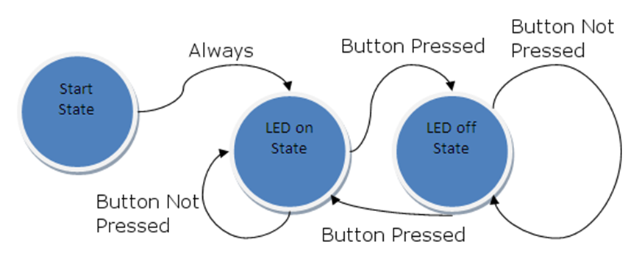


Graphs and Their Applications
Graphs have many real-world applications
Modeling a computer network like the Internet
Routes are simple paths in the network
Modeling a city map
Streets are edges, crossings are vertices
Social networks
People are nodes and their connections are edges
State machines
States are nodes, transitions are edges

Slide 184
Representing Graphs
3
2
Adjacency list
Each node holds a list of its neighbors
Adjacency matrix
Each cell keeps whether and how two nodes are connected
List of edges
1 → {2, 4}
2 → {3}
3 → {1}
4 → {2}
1
4
1
2
3
4
1
0 | 1 | 0 | 1
0 | 0 | 1 | 0
1 | 0 | 0 | 0
0 | 1 | 0 | 0
2
{1,2} {1,4} {2,3} {3,1} {4,2}
3
4

Slide 185
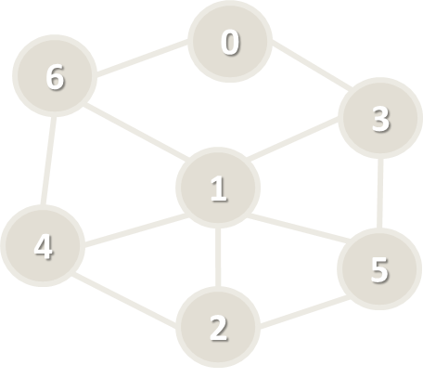
Graph Representation: Adjacency List
var g = new List<int>[] {
new List<int> {3, 6},
new List<int> {2, 3, 4, 5, 6},
new List<int> {1, 4, 5},
new List<int> {0, 1, 5},
new List<int> {1, 2, 6},
new List<int> {1, 2, 3},
new List<int> {0, 1, 4}
};
// Add an edge { 3 → 6 }
g[3].Add(6);
// List the children of node #1
var childNodes = g[1];

Slide 186
Graph Representation: Adjacency Matrix
var graph = new[,]
{ // 0 1 2 3 4 5 6
{ 0, 0, 0, 1, 0, 0, 1 }, // node 0
{ 0, 0, 1, 1, 1, 1, 1 }, // node 1
{ 0, 1, 0, 0, 1, 1, 0 }, // node 2
{ 1, 1, 0, 0, 0, 1, 0 }, // node 3
{ 0, 1, 1, 0, 0, 0, 1 }, // node 4
{ 0, 1, 1, 1, 0, 0, 0 }, // node 5
{ 1, 1, 0, 0, 1, 0, 0 }, // node 6
};
// Add an edge { 3 → 6 }
g[3, 6] = 1;
// List the children of node #1
var childNodes = g[1];

Slide 187
Graph Representation: List of Edges
class Edge
{
public int Parent {get; set; }
public int Child {get; set; } }
var graph = new List<Edge>() {
new Edge() { Parent = 0, Child = 3 },
new Edge() { Parent = 0, Child = 6 },
…
}
// Add an edge { 3 → 6 }
graph.Add(new Edge() { Parent = 3, Child = 6 });
// List the children of node #1
var childNodes = graph.Where(e => e.Parent == 1);

Slide 188
Numbering Graph Nodes
A common technique to speed up working with graphs
Numbering the nodes and accessing them by index (not by name)
Ruse
0
Plovdiv
6
3
Varna
1
Sofia
4
Bourgas
5
Stara Zagora
2
Pleven
Graph of numbered nodes: [0…6]
Graph of named nodes

Slide 189
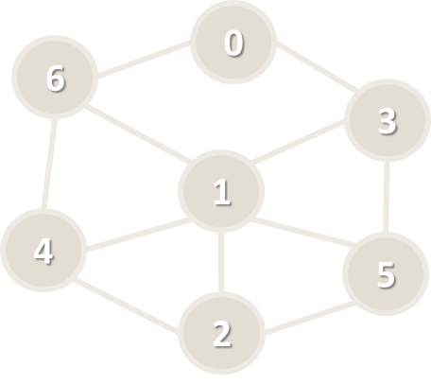
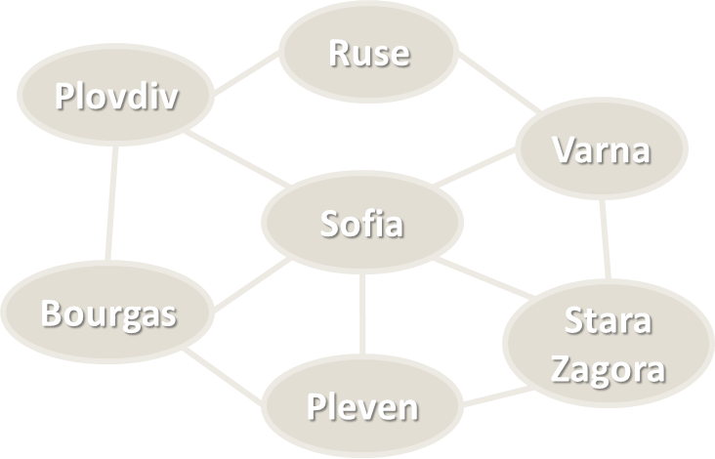
Numbering Graph Nodes – How?
Suppose we have a graph of n nodes
We can assign a number for each node in the range [0…n-1]
# | Node
0 | Ruse
1 | Sofia
2 | Pleven
3 | Varna
4 | Bourgas
5 | Stara Zagora
6 | Plovdiv
var g =
new List<int>[n]
var g = new Dictionary<
string, List<string>>

Slide 190

Graph of Named Nodes – Example
var graph = new Dictionary<string, List<string>>() {
{ "Sofia", new List<string>() {
"Plovdiv", "Varna", "Bourgas", "Pleven", "Stara Zagora" } },
{ "Plovdiv", new List<string>() {
"Bourgas", "Ruse" } },
{ "Varna", new List<string>() {
"Ruse", "Stara Zagora" } },
{ "Bourgas", new List<string>() {
"Plovdiv", "Pleven" } },
{ "Ruse", new List<string>() {
"Varna", "Plovdiv" } },
{ "Pleven", new List<string>() {
"Bourgas", "Stara Zagora" } },
{ "Stara Zagora", new List<string>() {
"Varna", "Pleven" } },
};

Slide 191
Graph of Numbered Nodes – Example
public class Graph
{
List<int>[] childNodes;
string[] nodeNames;
}
Graph g = new Graph(new List<int>[] {
new List<int> {3, 6}, // children of node 0 (Ruse)
new List<int> {2, 3, 4, 5, 6}, // successors of node 1 (Sofia)
new List<int> {1, 4, 5}, // successors of node 2 (Pleven)
new List<int> {0, 1, 5}, // successors of node 3 (Varna)
new List<int> {1, 2, 6}, // successors of node 4 (Bourgas)
new List<int> {1, 2, 3}, // successors of node 5 (Stara Zagora)
new List<int> {0, 1, 4} // successors of node 6 (Plovdiv)
},
new string[] {"Ruse", "Sofia", "Pleven", "Varna", "Bourgas", … });

Slide 192
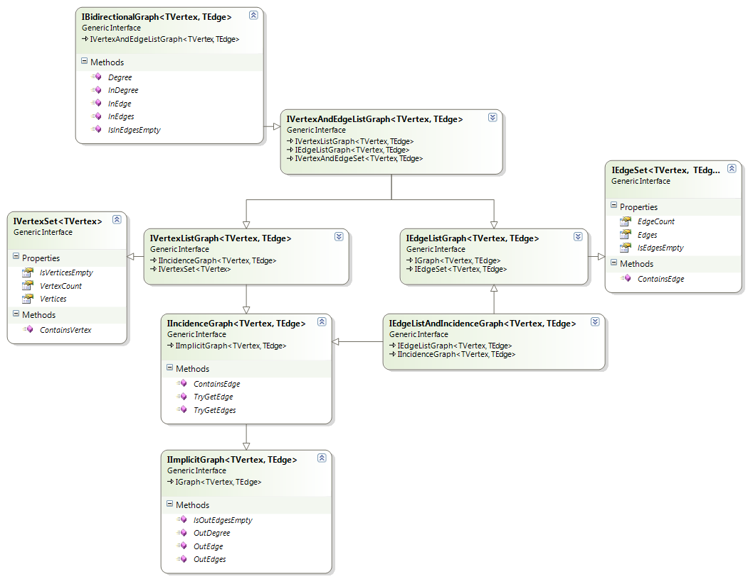
OOP-Based-Graph Representation
Using OOP:
Class Node
Class Edge (Connection)
Class Graph
Optional classes
Algorithm classes
Using external graph and algorithms library:
QuickGraph – http://quickgraph.codeplex.com

Slide 193
Depth-First Search (DFS)
Depth-First Search (DFS) first visits all descendants of given node recursively, finally visits the node itself
9
1
visited[0 … n-1] = false;
for (v = 0 … n-1) DFS(v)
DFS (node)
{
if not visited[node] {
visited[node] = true;
for each child c of node
DFS(c);
print node;
}
}
8
19
6
21
5
14
1
2
7
4
3
7
12
31
23
6

Slide 194
Breadth-First Search (BFS)
Breadth-First Search (BFS) first visits the neighbor nodes, then the neighbors of neighbors, then their neighbors, etc.
1
7
BFS (node)
{
queue ← node
visited[node] = true
while queue not empty
v ← queue
print v
for each child c of v
if not visited[c]
queue ← c
visited[c] = true
}
2
19
3
21
4
14
5
6
7
8
9
1
12
31
23
6

Slide 195
Popular graph algorithms
We barely touched the surface of the graph theory
There are many algorithms for practical tasks:
Connected Components – finds subgraphs
Topological Sorting – returns the graph in a sorted manner
Minimum Spanning Tree – finds a tree in the graph
Dijkstra’s Algorithm – finds the shortest paths in a graph
Bi-Connectivity – finds articulation points in a graph
Max Flow – finds a network flow in a graph
A* - a pathfinding algorithm to a single destination
If you are interested in a workshop about these algorithms, let me know ☺

Slide 196
Combining data structures

Slide 197
Data Structure Efficiency – Comparison
Data Structure | Add | Find | Delete | Get-by-index
Static array: T[] | O(n) | O(n) | O(n) | O(1)
Double-linked list: LinkedList<T> | O(1) | O(n) | O(n) | O(n)
Auto-resizable array-based list: List<T> | O(1) | O(n) | O(n) | O(1)
Stack: Stack<T> | O(1) | - | O(1) | -
Queue: Queue<T> | O(1) | - | O(1) | -

Slide 198
Data Structure Efficiency – Comparison
Data Structure | Add | Find | Delete | Get-by-index
Hash-table: Dictionary<K,V> | O(1) | O(1) | O(1) | -
Balanced tree-based dictionary: SortedDictionary<K,V> | O(log n) | O(log n) | O(log n) | -
Hash-table-based set: HashSet<T> | O(1) | O(1) | O(1) | -
Balanced tree-based set: SortedSet<T> | O(log n) | O(log n) | O(log n) | -

Slide 199
Combining Data Structures
Many scenarios → combine several DS
No ideal DS → choose between space and time
For example, we can combine:
A hash-table for fast search by key₁ (e.g. name)
A hash-table for fast search by {key₂ + key₃} (e.g. name + town)
A balanced search tree for fast extract-range(start_key … end_key)
A rope for fast access-by-index
A balanced search tree for fast access-by-sorted-index

Slide 200
Exercise: Collection of people
Design a data structure that efficiently implements:
Hint: Implement everything by using lists only to assert your logic
Hint: Check Wintellect Power Collections
Operation | Return Type
Add(email, name, age, town) | bool – unique email
Find(email) | Person or null
Delete(email) | bool
Find-All(email_domain) | IEnumerable<P> – sorted by email
Find-All(name, town) | IEnumerable<P> – sorted by email
Find-All(start_age, end_age) | Ienumerable<P> – sorted by age, email
Find-All(start_age, end_age, town) | Ienumerable<P> – sorted by age, email

Slide 201
ANY QUESTIONS?

